Slide 1
Predicting the Severity of Car Accidents in Seattle
Problem:
This project will predict the possibility of getting into a car accident and the severity of them, taking in mind the climate and the roads condition in Seattle.

Slide 2
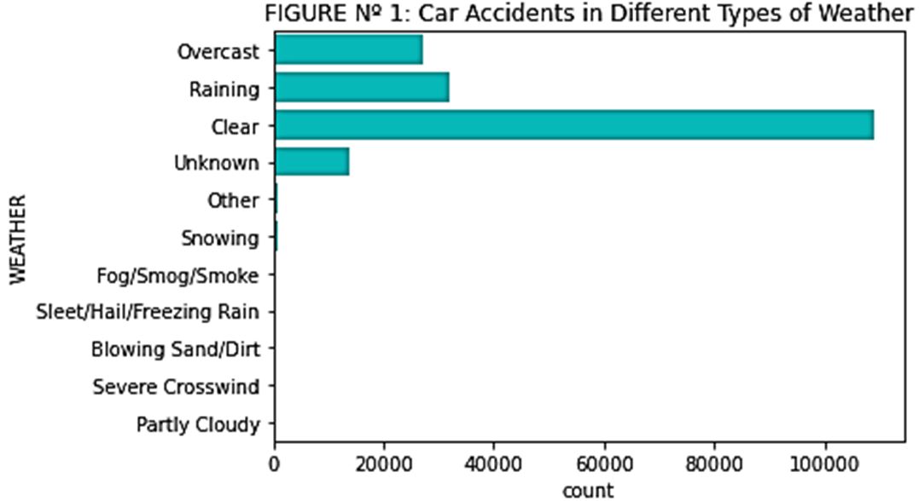
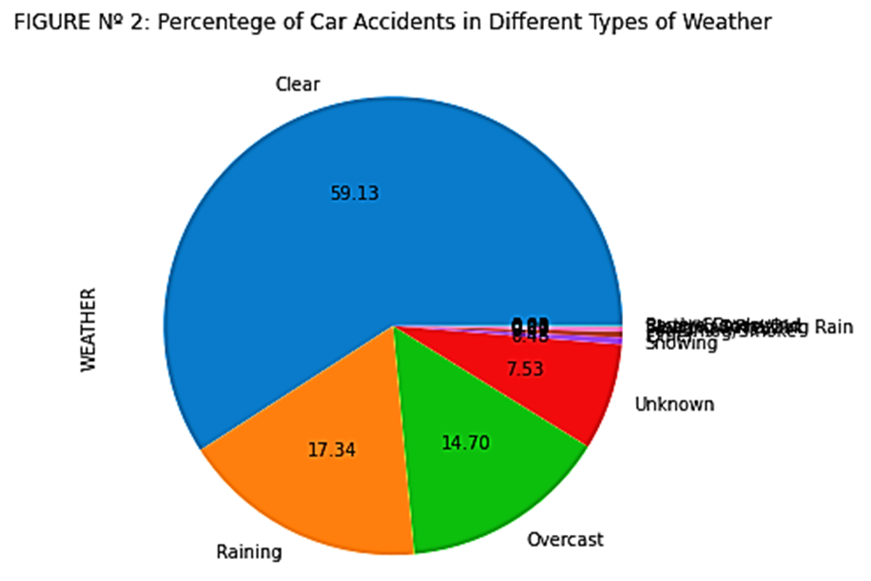

Slide 3
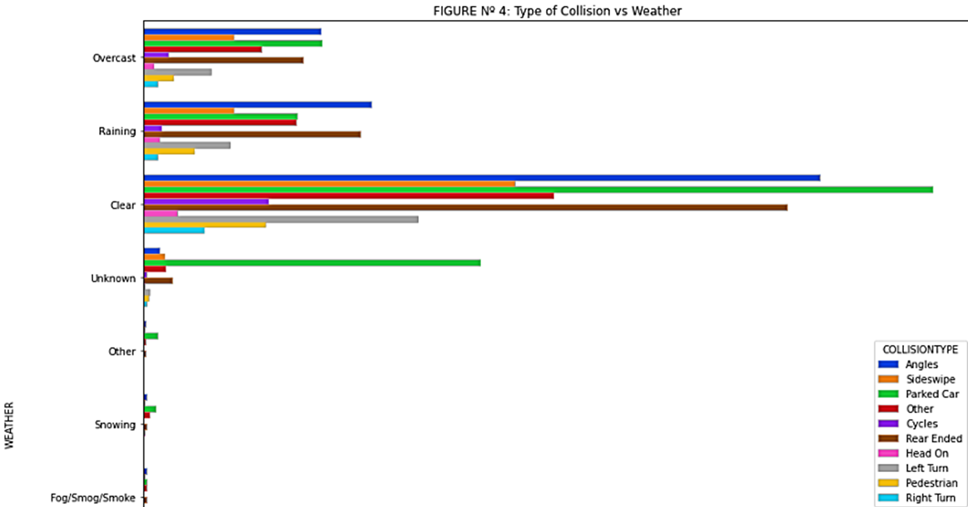
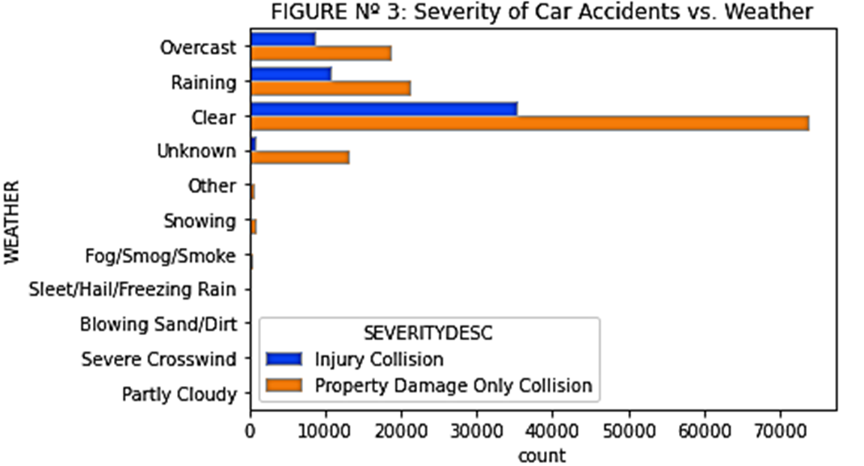

Slide 4
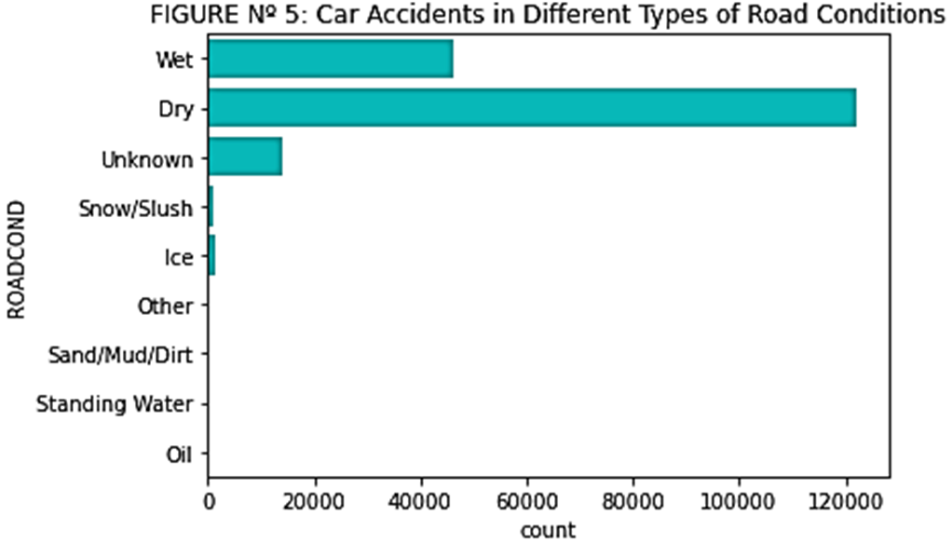
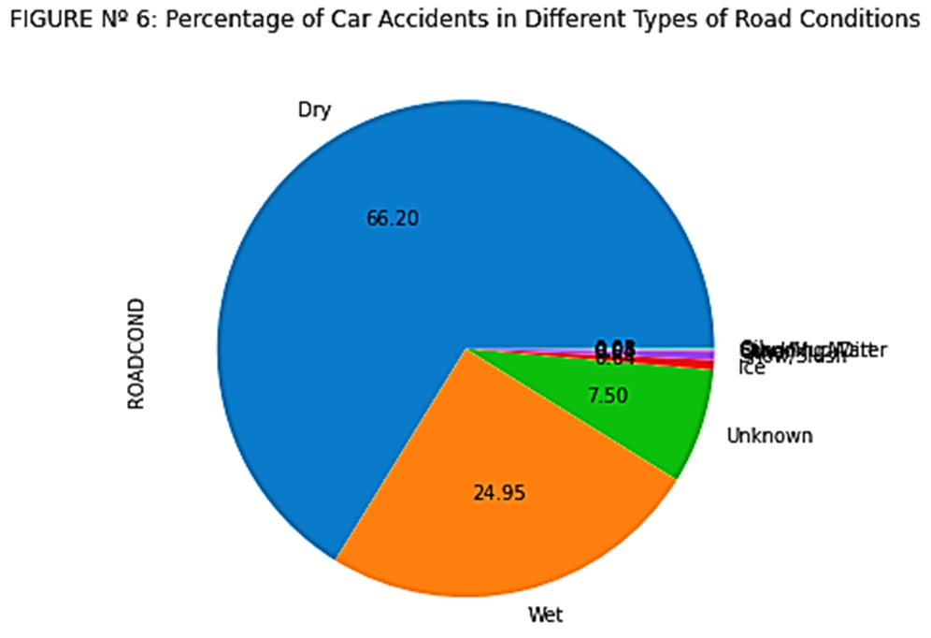

Slide 5
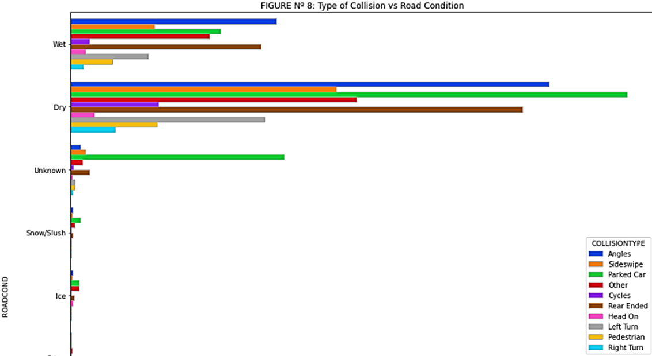
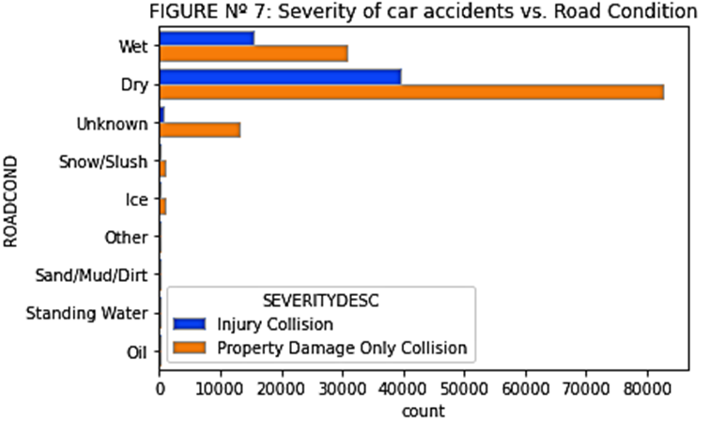

Slide 6
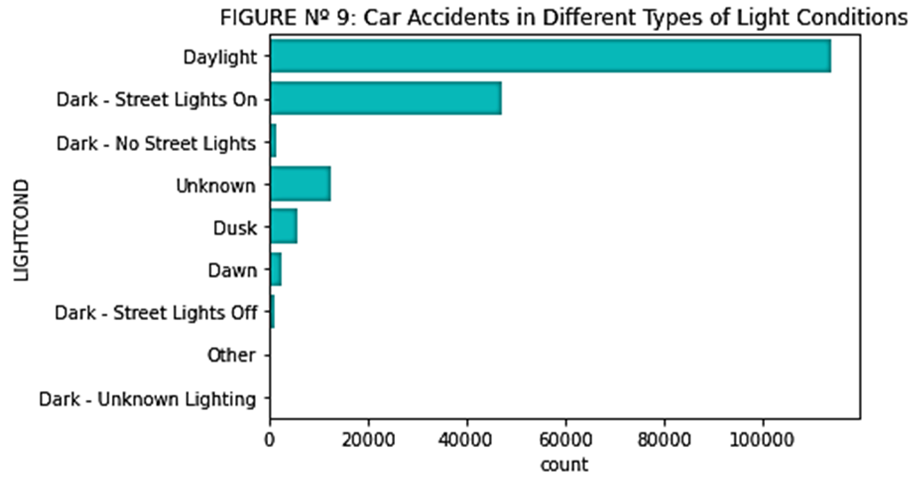
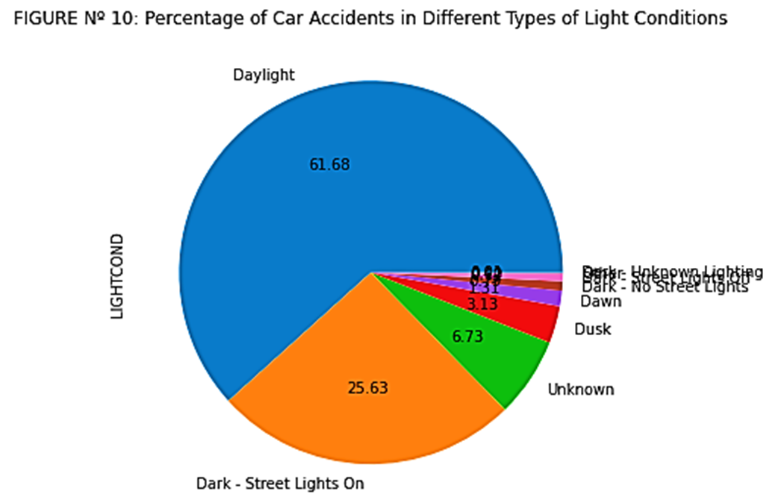

Slide 7
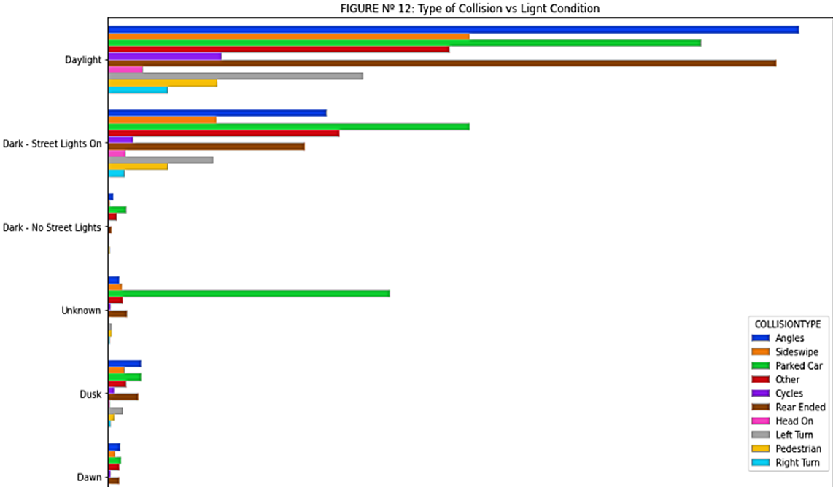
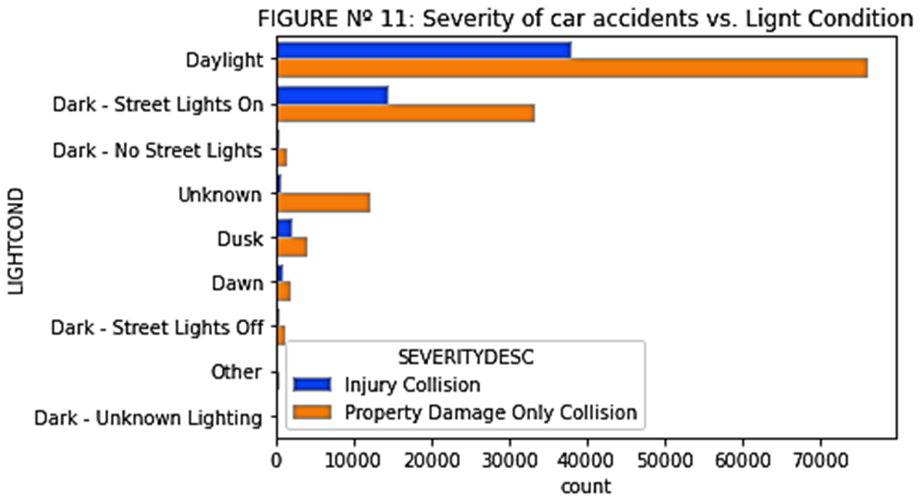

Slide 8
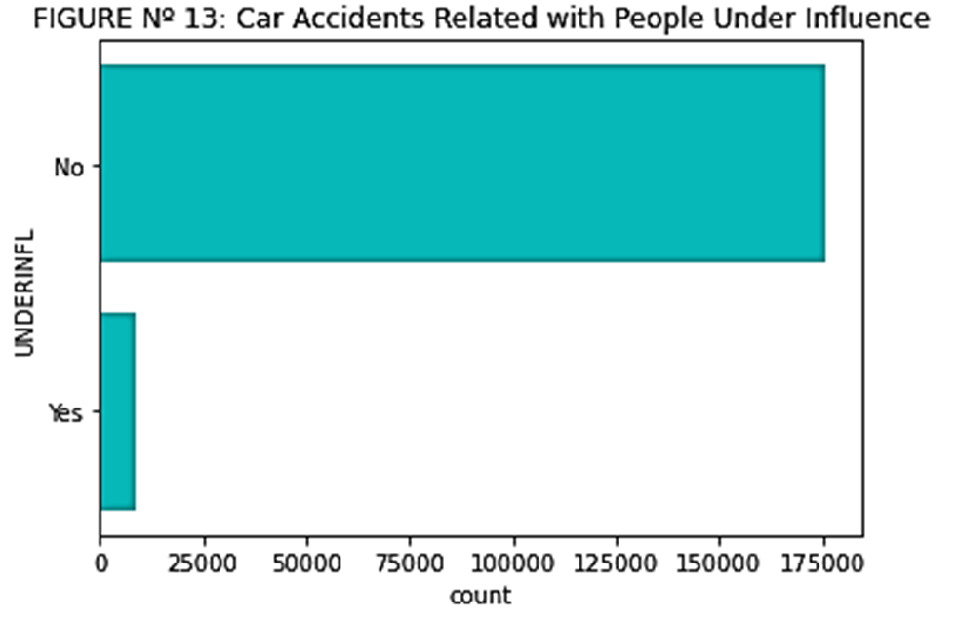
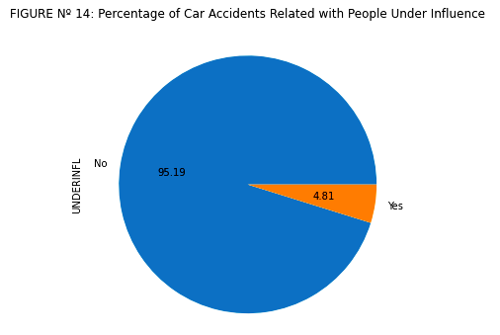

Slide 9
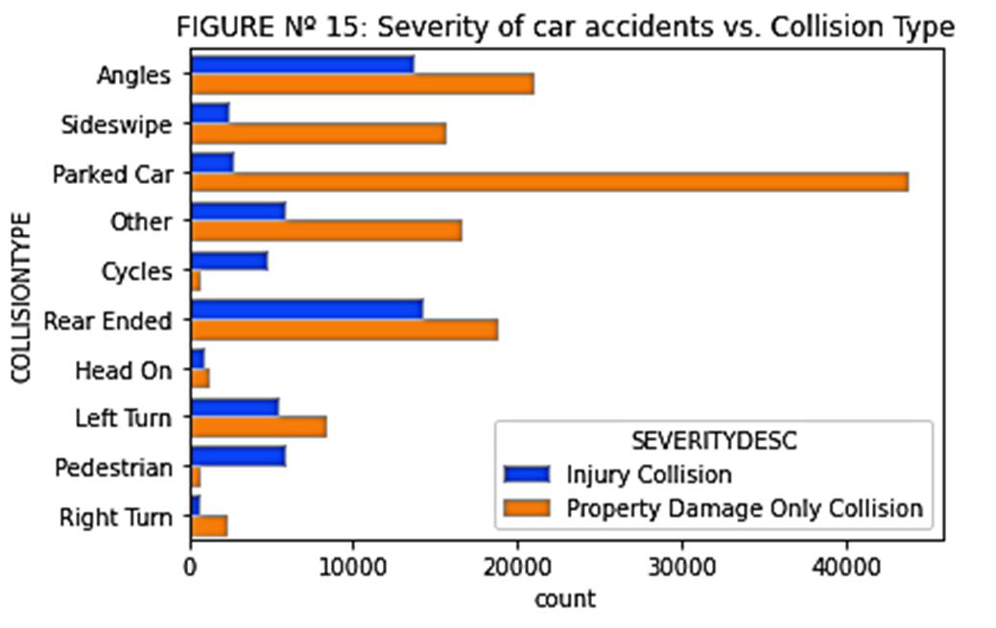
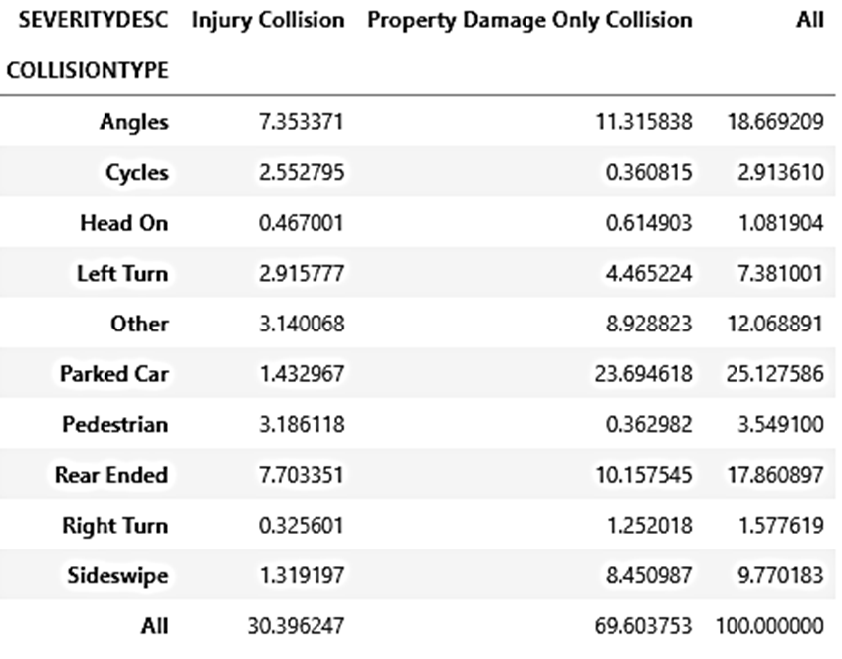

Slide 10
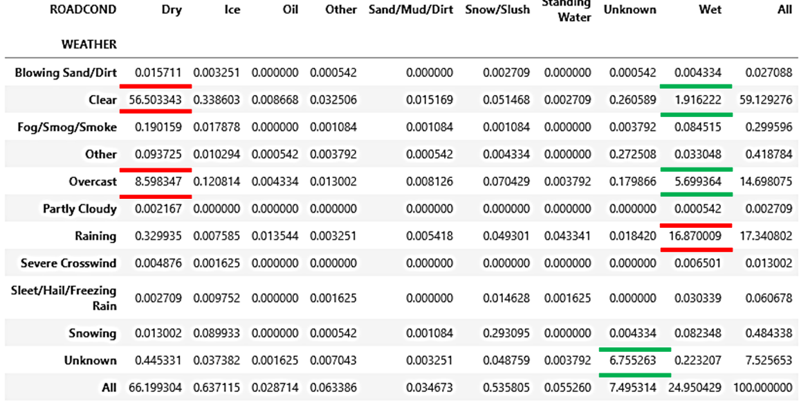
TABLE Nº 12: Distribution of Percentage of Car Accidents Between Weather and Road Condition

Slide 11
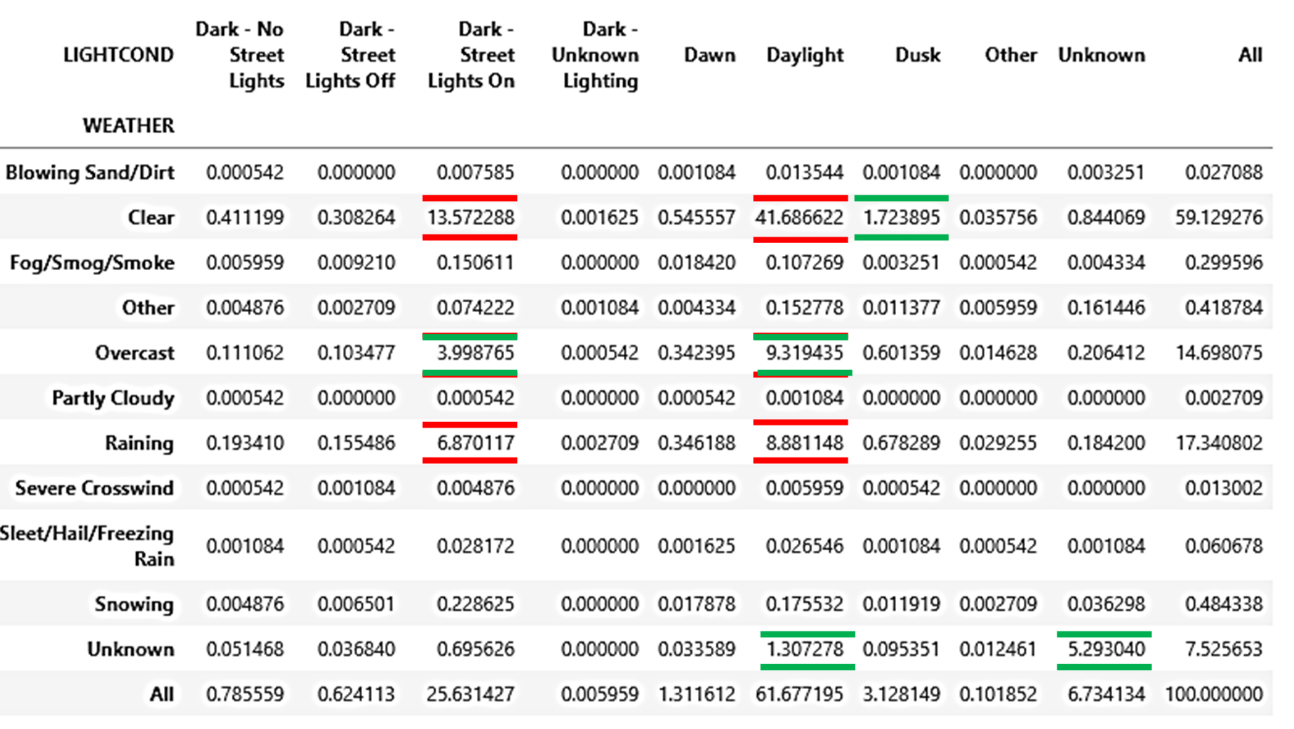
TABLE Nº 13: Distribution of Percentage of Car Accidents Between Weather and Light Condition

Slide 12

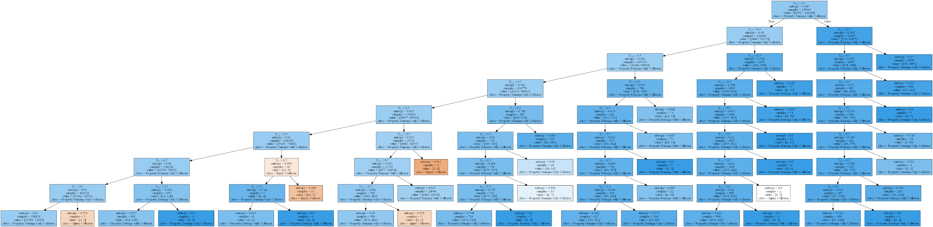
PLOT Nº 1: Decision Tree Between Weather, Road Condition and Light Condition vs. Severity of Car Accidents
Link to a better quality
PLOT Nº 2: Decision Tree Between Weather, Road Condition vs. Severity of Car Accidents
Link to a better quality

Slide 13
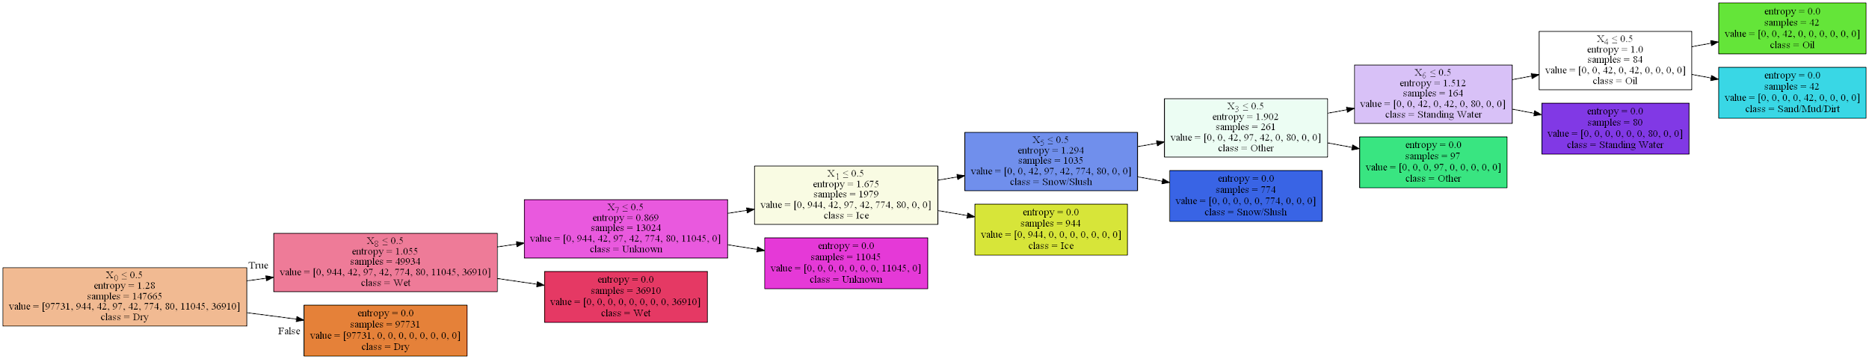
PLOT Nº 3: Decision Tree Between Weather vs. Road Condition
Link to a better quality

Slide 14
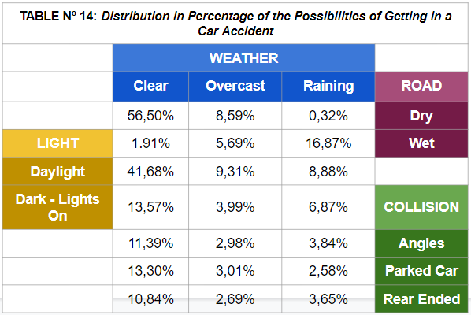

Slide 15
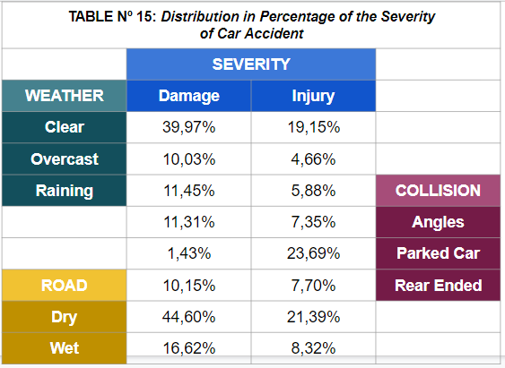

Slide 16
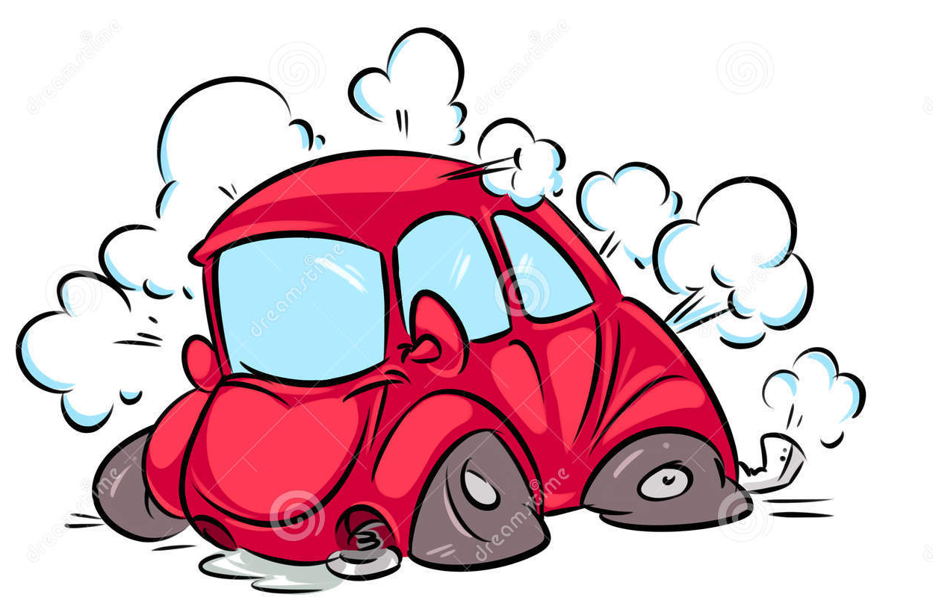
Thank you

